Slide 1


DATA STRUCTURES AND ALGORITHMS
Hash Table
CCE 105
Data Structures
Prepared by:

Slide 2


Topics
Hashing
Hashing Techniques
Collision Resolution Techniques

Slide 3

01
Hashing

Slide 4

A hash table is a data structure that offers very fast insertion and searching. For a human user of a hash table, this is essentially instantaneous. It’s so fast that computer programs typically use hash tables when they need to look up tens of thousands of items in less than a second (as in spelling checkers).
Hash Tables

Slide 5
One important concept is how a range of key values is transformed into a range of array index values. In a hash table this is accomplished with a hash function. However, for certain kinds of keys, no hash function is necessary; the key values can be used directly as array indices.
Hash Tables

Slide 6
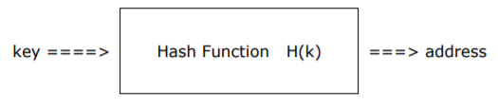
Hashing is the application of a mathematical function (called a hash function) to the key values that results in mapping the possible range of key values into a smaller range of relative addresses. The hash function is something like a locked box that needs a key to get the output which, in this case, is the address where the key is stored:
Hashing

Slide 7
With hashing, there is no obvious connection between the key and the address generated since the function "randomly selects" an address for a specific key value, without regard to the physical sequence of the records in the file. Hence, it is also known as randomizing scheme.
Hashing

Slide 8
Two or more input keys, say k1 and k2, when applied to a hash function, may hash to the same address, an accident known as collision. Collision can be reduced by allocating more file space than the minimum required to store the number of keys. However, this approach leads to wasted space.
Hashing

Slide 9
In hashing, there is a need to choose a good hash function and consequently, select a method to resolve, if not eliminate, collisions. A good hash function performs fast computation and produces less (or no) collisions.
Hashing

Slide 10
02
Hashing Techniques

Slide 11

Prime Number Division Method This method is one of the most common randomizing scheme. If the key value is divided by a number n, the range of address generated will be of the form 0 to n-1. The formula is:
Simple Hash Techniques
Rule of thumb:
Pick a prime number, close to a power of two, to be n
Notes:
A prime number is a whole number greater than 1 whose only factors are 1 and itself. A factor is a whole number that can be divided evenly into another number. The first few prime numbers are 2, 3, 5, 7, 11, 13, 17, 19, 23 and 29.

Slide 12
Prime Number Division Method If n is the total number of relative locations in the file, this method can be used to map the keys into n record locations. n should be chosen to attempt to reduce number of collisions. If n is even, the result of the hash function has revealed an even value and if n is odd, the resulting value is also odd.
Simple Hash Techniques

Slide 13
Prime Number Division Method Division with a prime number will not result to much collision, that is why it is the best choice for the divisor in this method. We could choose a prime number that is close to the number of record positions in the file. However, this method may be used even if n is not a prime, but be prepared to handle more collisions.
Simple Hash Techniques

Slide 14
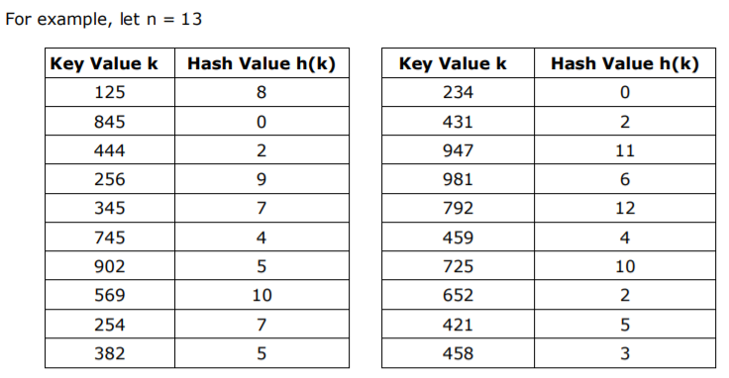

Prime Number Division Method
Simple Hash Techniques
In Java, to implement this hashing, it is as simple as:

Slide 15
Prime Number Division Method Division with a prime number will not result to much collision, that is why it is the best choice for the divisor in this method. We could choose a prime number that is close to the number of record positions in the file. However, this method may be used even if n is not a prime, but be prepared to handle more collisions.
Simple Hash Techniques

Slide 16
Folding In this technique, the key value is split into two or more parts and then added, ANDed, or XORed to get a hash address. If the resulting address has more digits than the highest address in the file, the excess high order digits are truncated.
Simple Hash Techniques

Slide 17
Folding There are different ways of folding. A key value can be folded in half. This is ideal for relatively small key values since they would easily fit in the available addresses. If in any case, the key would be unevenly split, the left fold must be greater than the right fold.
Simple Hash Techniques

Slide 18
Folding A key value can also be folded in thirds this is ideal for somewhat large key values. We can also fold alternate digits. The digits in the odd positions form one part, and the digits in the even positions form another.
Simple Hash Techniques

Slide 19
Folding Folding in half and in thirds can be done in yet another two ways. One is boundary folding where some parts of the folded keys are reversed (imitating the way we fold paper) and then summed. Last is shift folding where no parts of the folded keys are reversed.
Simple Hash Techniques

Slide 20
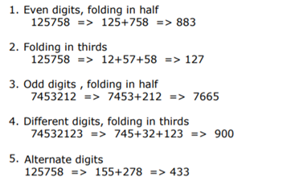
Folding The following are some examples of shift folding:
Simple Hash Techniques

Slide 21
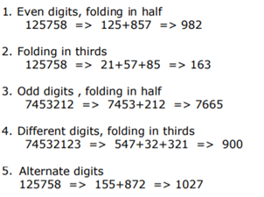
Folding The following are some examples of boundary folding:
Simple Hash Techniques

Slide 22
Folding This method is useful for converting keys with large number of digits to a smaller number of digits so the address fits into a word memory. It is also easier to store since the keys do not require much space to be stored.
Simple Hash Techniques

Slide 23
03
Collision Resolution Techniques

Slide 24

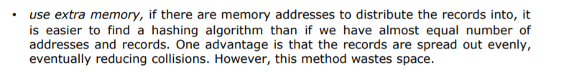
Choosing a good hashing algorithm based on how few collisions are likely to occur is the first step in avoiding collision. However, this will just minimize and will not eradicate the problem. To avoid collision, we could:
Collision Resolution Techniques
There are several collision resolution techniques and in this topic, we will cover chaining, use of buckets and open addressing.

Slide 25
Chaining In chaining, m linked lists are maintained, one for each possible address in the hash table.
Collision Resolution Techniques

Slide 26
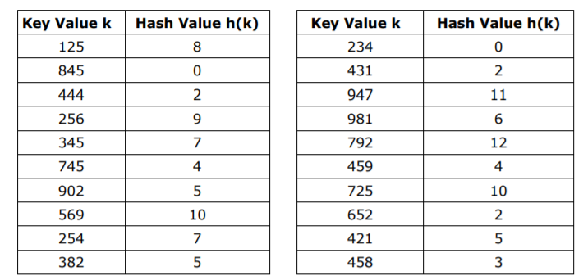
Chaining
Collision Resolution Techniques
Using chaining to resolve collision in storing the example in Prime Number Division Method of hashing:

Slide 27
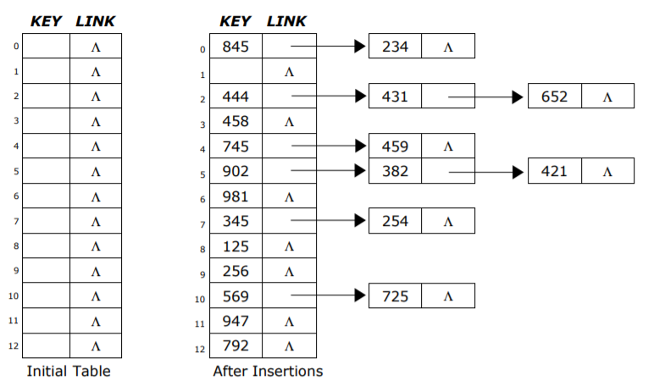
Chaining
Collision Resolution Techniques
Keys 845 and 234 both hash to address 0 so they are linked together in the address. The case is the same for addresses 2, 4, 5, 7 and 10, while the rest of the addresses have no collision. The chaining method resolved the collision by providing additional link nodes to each of the values.

Slide 28
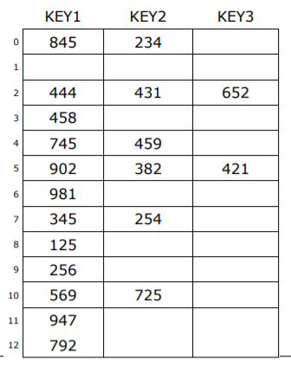
Use of Bucket Like chaining, this method divides the hash table into m groups of records where each group contains exactly b records, having each address regarded as a bucket.
Collision Resolution Techniques

Slide 29
Use of Bucket
Collision Resolution Techniques
Collision is redefined in this approach. It happens when a bucket overflows – that is, when an insertion is attempted on a full bucket. Hence, there is a significant reduction in the number of collisions. However, this method wastes some space and is not free from overflowing further, in which case an overflow policy must be invoked. In the above example, there are three slots in each address. Being static in size, problem arises when more than three values hash to a single address.

Slide 30
Open Addressing (Probing) In open addressing, when the address produced by a hash function h(k) has no more space for insertion, an empty slot other than h(k) in the hash table is located. This process is called probing. In this empty slot, the new record that has collided with the old one, known as the colliding key, could be safely placed. In this lesson, we will cover two techniques: linear probing and double hashing.
Collision Resolution Techniques

Slide 31
Open Addressing (Probing) Linear Probing Linear probing is one of the simplest techniques in handling collisions in which the file is scanned or probed sequentially as a circular file and the colliding key is stored in the nearest available space to the address. This is used in systems where a “first come, first served” basis is followed. An example is an airline reservation system where seats for chance passengers are given away when passengers for reserved seats don’t arrive.
Collision Resolution Techniques

Slide 32
Open Addressing (Probing) Linear Probing Whenever a collision occurs at a certain address, the succeeding addresses are probed, that is, searched sequentially until an empty one is found. The key then uses this address. Array should be considered circular, so that when the last location is reached, the search proceeds to the first location of the array.
Collision Resolution Techniques

Slide 33
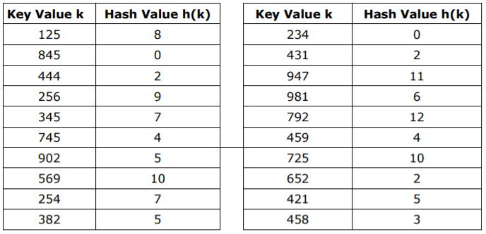
Open Addressing (Probing) Linear Probing
Collision Resolution Techniques
The slots in a hash table may contain only one key or could also be a bucket. In this example, buckets of capacity 2 are used to store the following keys:

Slide 34
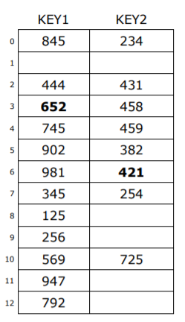
Open Addressing (Probing) Linear Probing
Collision Resolution Techniques
845
234
444
431
652
458
745
459
902
382
981
421
This approach resolves the problem of overflowing in bucket addressing. Also, probing for available space makes the storage of overflowed keys near its home address in most cases. However, this method suffers from displacement problem where the keys that rightfully owns an address may be displaced by other keys that just probed to the said address.
345
254
125
256
569
725
947
792

Slide 35
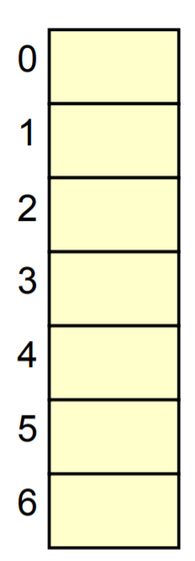
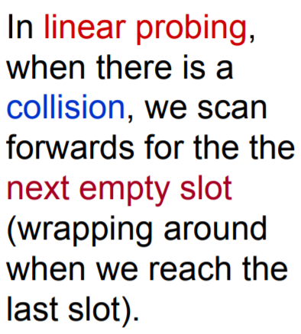
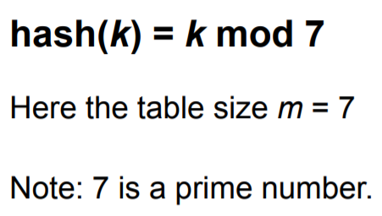
Open Addressing (Probing) Linear Probing
Collision Resolution Techniques
Example:

Slide 36
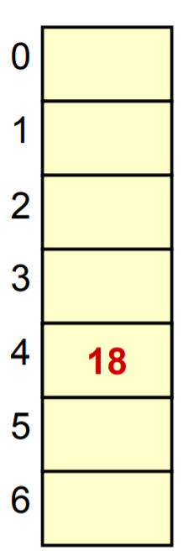
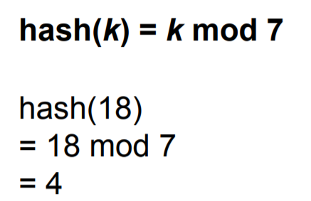
Open Addressing (Probing) Linear Probing
Collision Resolution Techniques
Example: Insert 18

Slide 37
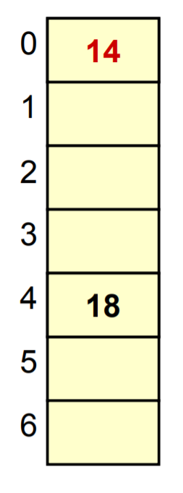
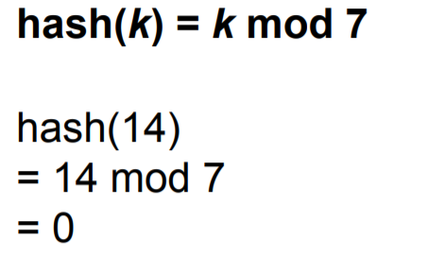
Open Addressing (Probing) Linear Probing
Collision Resolution Techniques
Example: Insert 14

Slide 38
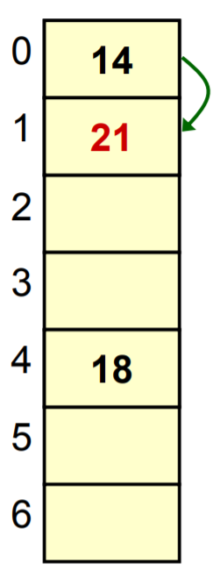
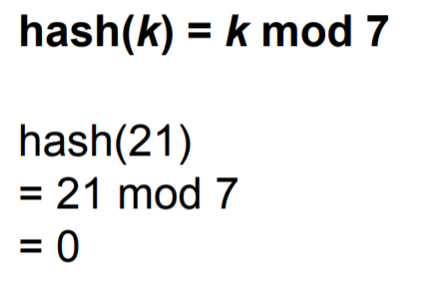
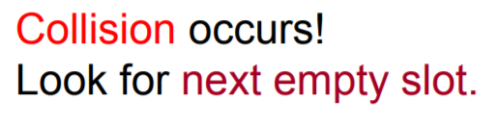
Open Addressing (Probing) Linear Probing
Collision Resolution Techniques
Example: Insert 21

Slide 39
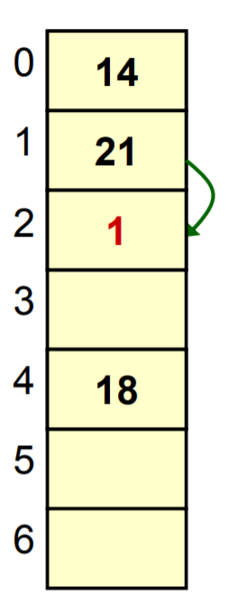
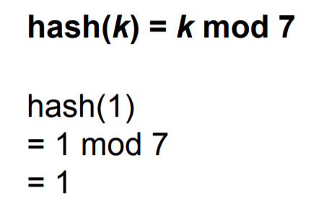
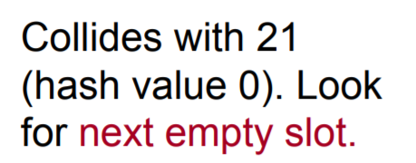
Open Addressing (Probing) Linear Probing
Collision Resolution Techniques
Example: Insert 1

Slide 40
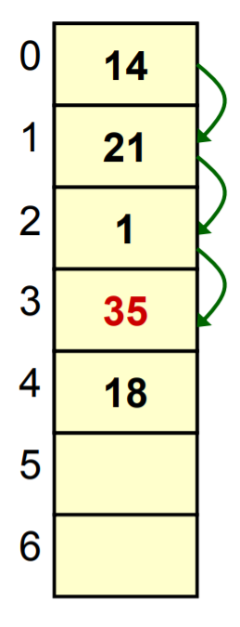
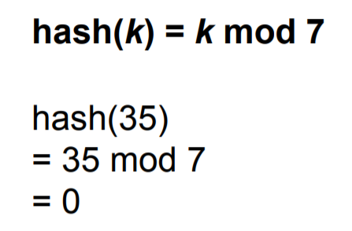
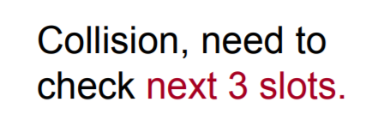
Open Addressing (Probing) Linear Probing
Collision Resolution Techniques
Example: Insert 35

Slide 41
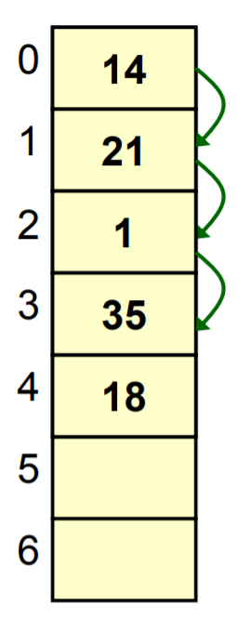
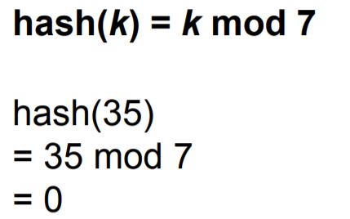
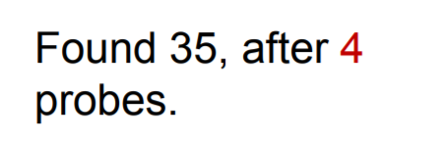
Open Addressing (Probing) Linear Probing
Collision Resolution Techniques
Example: Find 35

Slide 42
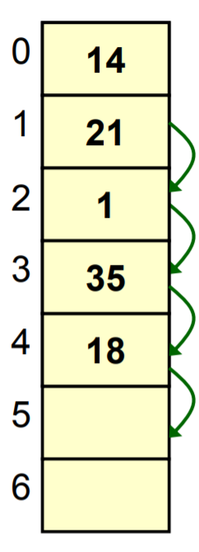
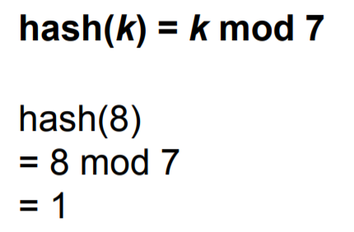

Open Addressing (Probing) Linear Probing
Collision Resolution Techniques
Example: Find 8

Slide 43
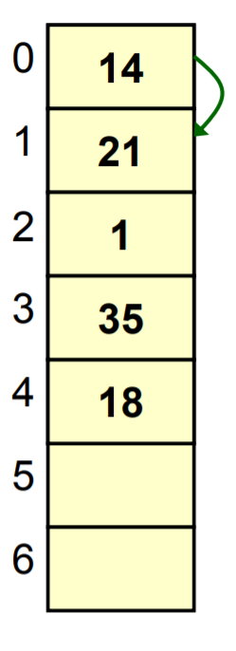
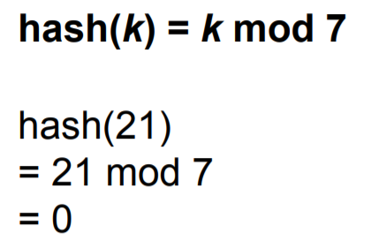
Open Addressing (Probing) Linear Probing
Collision Resolution Techniques
Example: Delete 21

Slide 44
Open Addressing (Probing) Linear Probing
Collision Resolution Techniques
Example: Delete 21
Delete 21

Slide 45
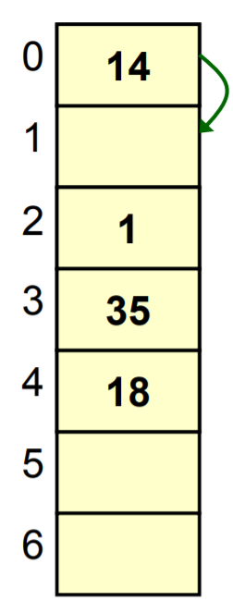
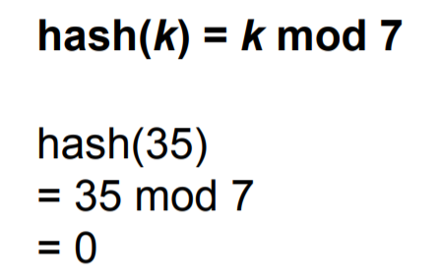
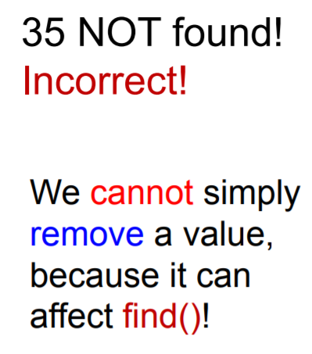
Open Addressing (Probing) Linear Probing
Collision Resolution Techniques
Example: Find 35

Slide 46
Open Addressing (Probing) Linear Probing
Collision Resolution Techniques
How to Delete?
Lazy Deletion
- Use three different states at each slot
Occupied
Deleted
Empty
When a value is removed from linear probed hash table, we just mark the status of the slot as “deleted”, instead of emptying the slot
Need to use a state array the same size as the hash table

Slide 47
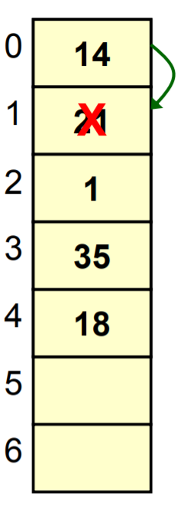
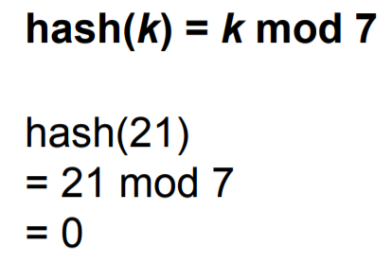
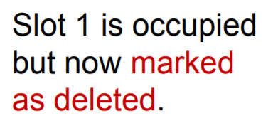
Open Addressing (Probing) Linear Probing
Collision Resolution Techniques
Example: Delete 21

Slide 48
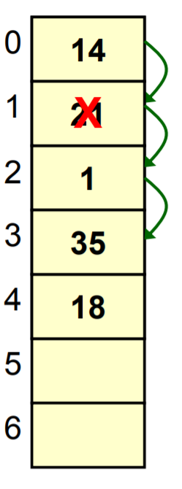
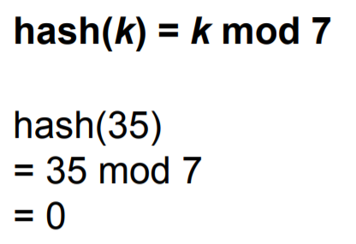
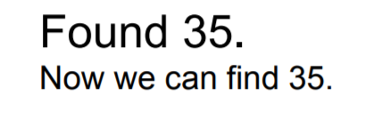
Open Addressing (Probing) Linear Probing
Collision Resolution Techniques
Example: Find 35

Slide 49
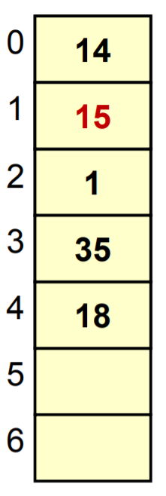
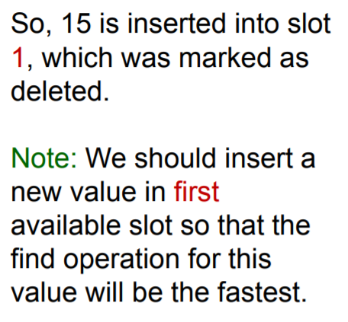
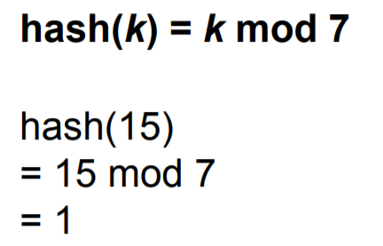
Open Addressing (Probing) Linear Probing
Collision Resolution Techniques
Example: Insert 15

Slide 50
Open Addressing (Probing) Double Hashing Double hashing makes use of a second hash function, say h2(k), whenever there's a collision. The record is initially hashed to an address using the primary function. If the hashed address is not available, a second hash function is applied and added to the first hashed value, and the colliding key is hashed to the new address if there is available space. If there is none, the process is repeated.
Collision Resolution Techniques

Slide 51
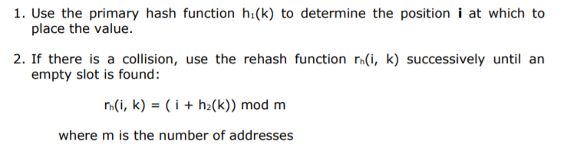
Open Addressing (Probing) Double Hashing The following is the algorithm:
Collision Resolution Techniques

Slide 52
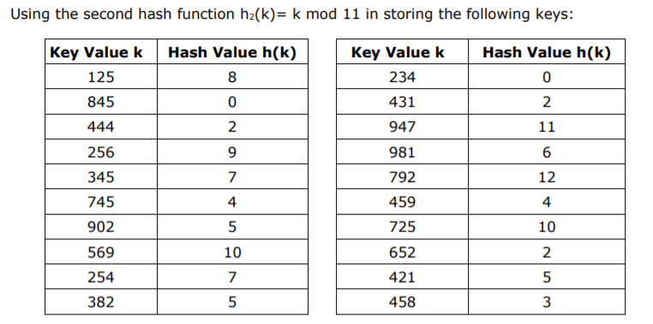
Open Addressing (Probing) Double Hashing
Collision Resolution Techniques

Slide 53
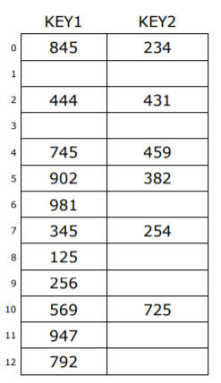
Open Addressing (Probing) Double Hashing
Collision Resolution Techniques

Slide 54
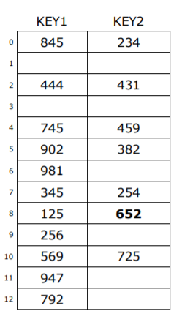
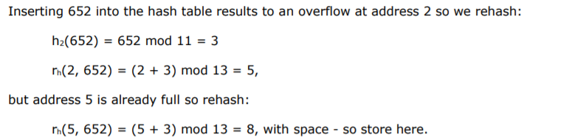

Open Addressing (Probing) Double Hashing
Collision Resolution Techniques
652

Slide 55



Open Addressing (Probing) Double Hashing
Collision Resolution Techniques
421

